Slide 1
What is Robotic Enterprises framework ?
Robotic Enterprises framework is a template that helps you design (automation) processes. At a barebones minimum, a framework should offer a way to store, read, and easily modify project configuration data, a robust The REFramework is implemented as a state machine, exception handling scheme, event logging for all exceptions and relevant transaction information.
which is a type of workflow that has two very useful features:
States that define actions to be taken according to the specified input
Transitions that move the execution between states depending on the outcomes of the states themselves.
You may remember state machines from the Project Organization course. One of the examples presented was the typical air conditioner:
It has the OFF State, from where it moves to an IDLE State by pressing the ON/OFF button;
From the IDLE State, it moves to either HEAT or COLD States when the temperature inputted by the user is lower and higher respectively than the current one. Once the desired temperature is achieved, it moves back to the IDLE State;
From the IDLE State, it can move to the OFF State when the ON/OFF button is pressed;
All the conditions that trigger the movements between the states are Transitions.

Slide 2
Four main states in REF
Initial State
This is where the process starts. It's an operation where the process initializes the settings and performs application checks in order to make sure all the prerequisites for the starting the process are in place.
Get Transaction Data State
Gets the next transaction item. This can be a queue item or any item of a collection.
By default, transaction items are queue items, but this can be easily changed to suit your needs. This is also the state in which the Developer should set up the condition to exit this state when there are no items to process.
Process Transaction State
Performs actions/applies logic in various applications for the transaction item obtained at the previous step. Once a transaction item is processed, the process continues with the next available transaction item.
End Process State
The process ends (and the applications opened during the automation should be gracefully closed).

Slide 3
REFramework Features
Settings
In many processes, it is common to have certain settings and configuration values that are read during the initialization phase. Examples of settings include URLs to access web applications, Orchestrator queue names and default logging messages.
Logging
Another powerful feature of the REFramework is the built-in logging mechanism. Most of the workflows that compose the framework use Log Message activities that output details of what is happening in each step of the execution.
Business Exception & Application Exception
During the execution of most processes, there can be situations that are not part of the normal execution flow and they need to be addressed to achieve a more robust automation.

Slide 4
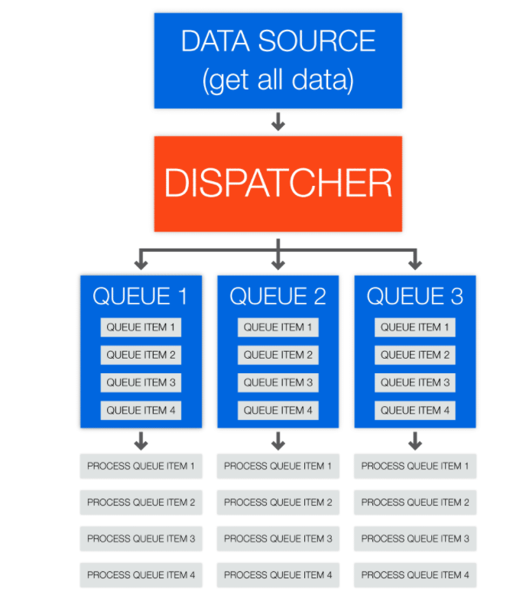
Dispatcher
Although the REFramework can be used with different types of data sources, it provides a particularly strong integration with Orchestrator queues. When queues are used, it is possible to define priorities and deadlines for transaction items and to track retrying attempts of failed transactions.
The use of queues also enables an execution pattern called Dispatcher & Performer, which divides the process in two main phases: dispatching items to be processed and adding them to a queue, followed by retrieving an item from a queue and performing the process using that item. The second part of the process is generally built using the REFramework.
Dispatcher
The dispatcher is a process used to push transaction items to an Orchestrator queue. It extracts data from one or multiple sources and uses it to create Queue items to be processed by Performer robots.
Information is pushed to one or more queues allowing the dispatcher to use a common format for all data stored in queue items.
The major advantage of using a dispatcher pattern is that you can split the processing of the items between multiple robots.

Slide 5
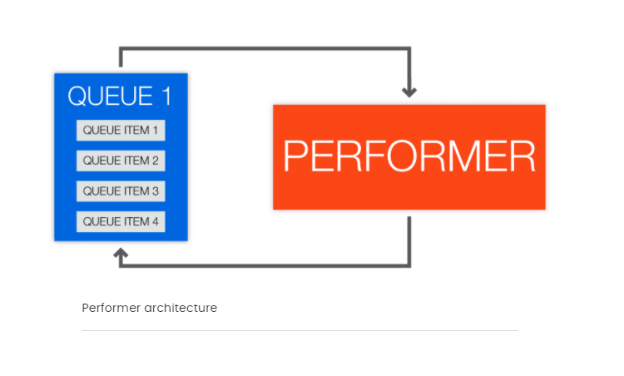
Performer
The performer is a process used to pull transaction items from an orchestrator queue and process them as needed in the company. Queue items are processed one at a time.
It uses error handling and retry mechanisms for each processed item.
A major advantage of the performer is its scalability (multiple performers can be used with a single queue)

Slide 6
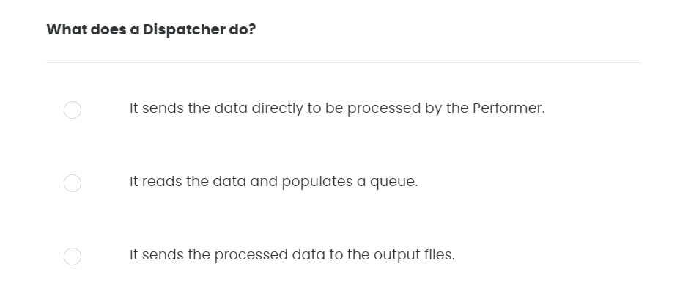
Quiz 01/10

Slide 7
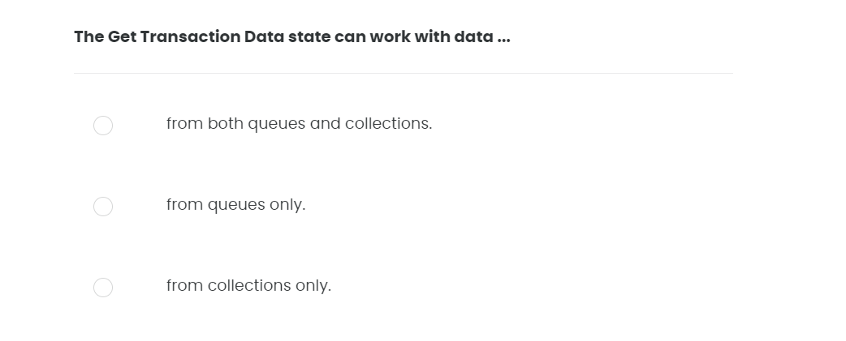
Quiz 02/10

Slide 8
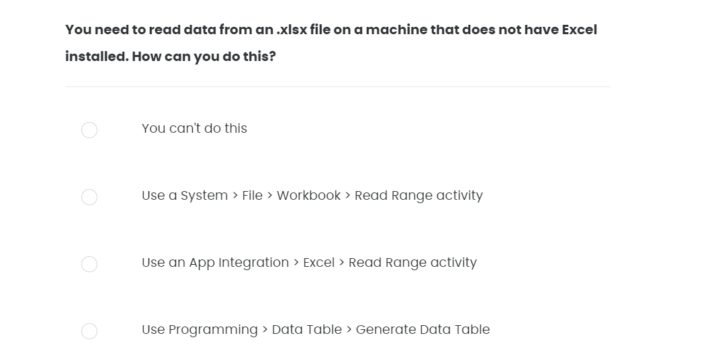
Quiz 03/10

Slide 9
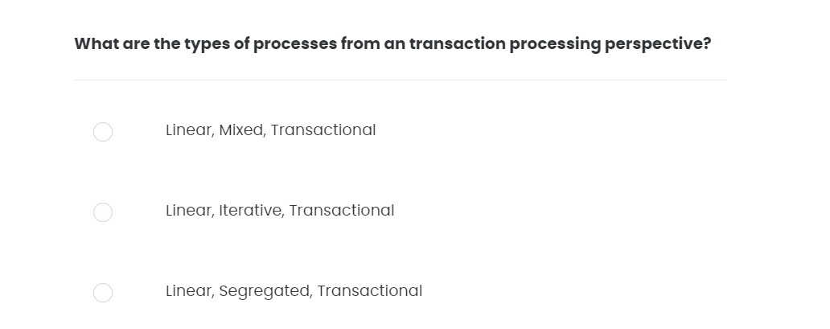
Quiz 04/10

Slide 10
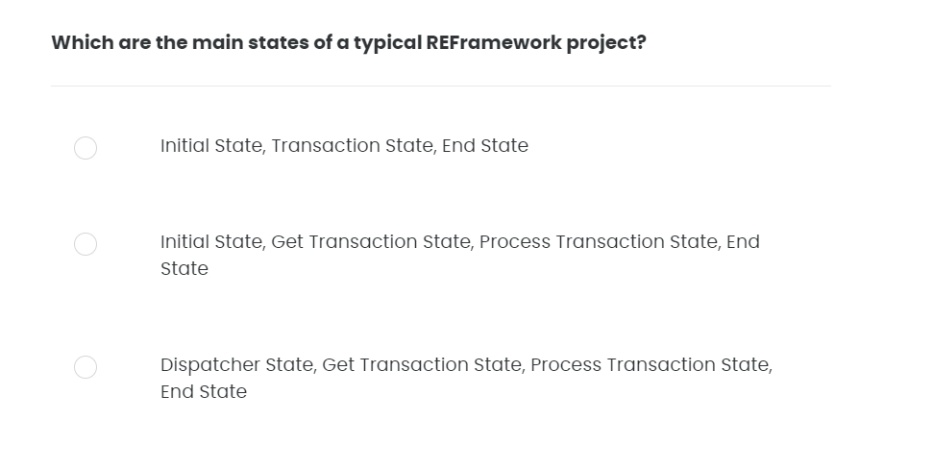
Quiz 05/10

Slide 11
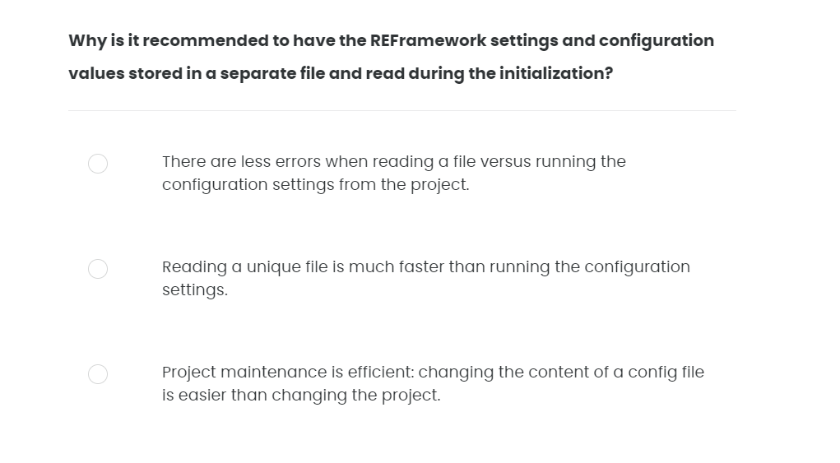
Quiz 06/10

Slide 12
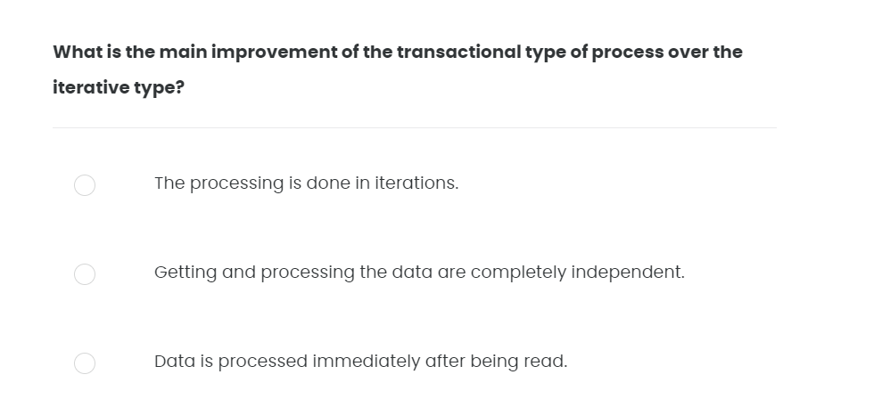
Quiz 07/10

Slide 13
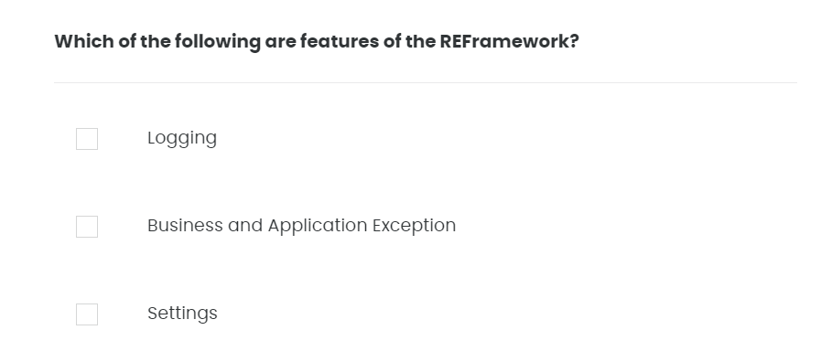
Quiz 08/10

Slide 14
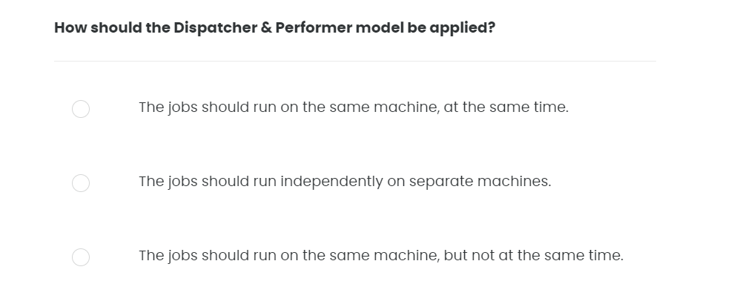
Quiz 09/10

Slide 15
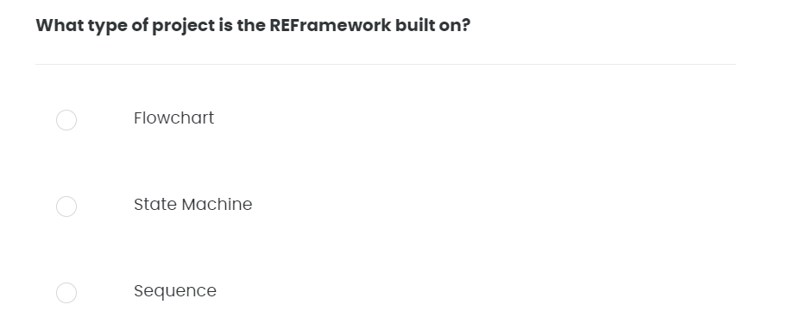
Quiz 10/10

